Slide 1
Murder by AUSTERITY
Grenfell Tower and the rise of the UK Left

Slide 2
The 8th June election
Conservative poll lead over 20%
Media all agreed Corbyn is no-hope candidate
Corbyn first openly anti-austerity candate outside Scotland
  Labour’s manifesto is balanced-budget
  Spending matched by taxes on high income
Mass rallies attended by tens of thousands
Corbyn promises to abolish tuition fees
After terror attack calls for national dialogue on the connection between war and terror

Slide 3
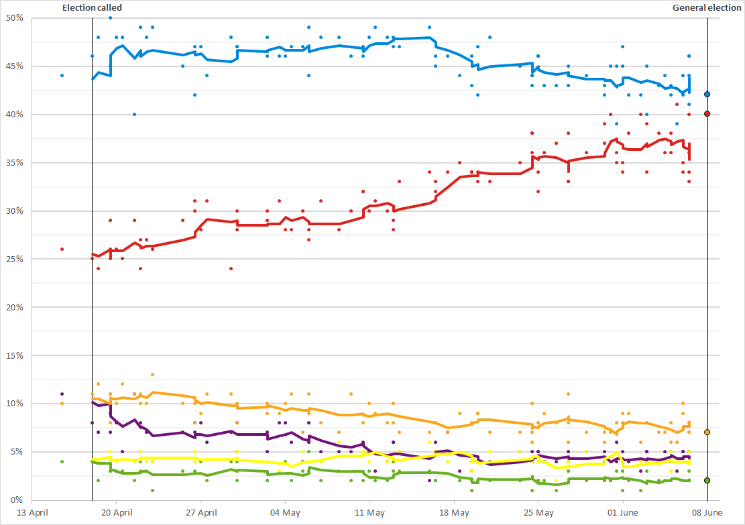

Slide 4
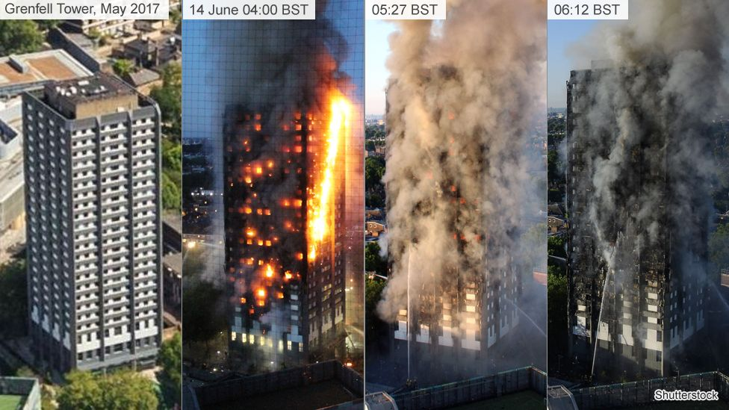

Slide 5


Slide 6
The warnings
The Grenfell Action Group used its blog on at least eight occasions in the last three years to say fire safety standards were inadequate in the 24-storey tower and that the building's landlord, the Kensington and Chelsea Tenant Management Organisation (KCTMO), needed to do more. On 20 November last year it wrote:
“It is a truly terrifying thought but the Grenfell Action Group firmly believe that only a catastrophic event will expose the ineptitude and incompetence of our landlord, the KCTMO, and bring an end to the dangerous living conditions and neglect of health and safety legislation that they inflict upon their tenants and leaseholders.”
The post went on to say that
"only an incident that results in serious loss of life of KCTMO residents will allow the external scrutiny to occur that will shine a light on the practices that characterise the malign governance of this non-functioning organisation."

Slide 7
Fire risks
In February 2013 residents warned fire safety equipment, including fire extinguishers, had not been tested for 12 months.
The tower block was given a medium fire risk rating - defined as a normal fire risk - in 2016 following completion of the refurbishment by the London Fire Brigade and Kensington and Chelsea Council.
The fire safety advice for Grenfell Tower residents was to "stay put" - unless the fire was affecting their own flat.
Tower block flats are built as a fire-resistant box, completely surrounded by fire-resisting construction from the rest of the building.
There are no sprinklers
Fire service could not reach above the 12th Floor

Slide 8
Fire service cuts
The Fire Brigades Union had warned that the public “would pay the price” for axing firefighters.
Deaths from fires in the home increased by 17.4% between April 2015 and March 2016, said Home Office figures. This meant there were 34 more fatalities than in the previous year.
The average response time to primary fires increased by 31 seconds since 2010, the report said.
Matt Wrack, FBU general secretary, said earlier this year: “Firefighters are doing their best to provide a world class service but the Government have compromised the service by axing thousands of posts, closing fire stations and cutting equipment.
“The decision to prioritise budget cuts ahead of public safety is another example of how out of touch this government is. In a fire, every second counts. Those extra seconds might not sound like long, and ministers will try to dismiss them, but in an emergency, that time can be the difference between life and death.”
As a result of government cuts 10,000 frontline fire fighter jobs have gone since 2010 – one in six. Stations, 140 appliances and equipment have also been cut.

Slide 9
The cladding
The cladding - installed on Grenfell Tower in a recent renovation - has come under scrutiny.
Both the cladding and insulation on the outside of the building failed all preliminary tests by the police. The insulation samples burned more quickly than the cladding tiles.
Documents obtained by the BBC suggest the cladding fitted during its refurbishment was changed to a cheaper version.

Slide 10
“The zinc cladding originally proposed was replaced with an aluminium type, which was less fire resistant, saving nearly £300,000”
£40 per year per tenant
£3,000 per life
The eventual cost will run to billions
This will come from the national taxpayer
There are no plans to fine the supplier
Or the council
Or KCTMO

Slide 11
Who’s next?
“The government announced plans to carry out tests on 600 buildings around the country, and so far at least 259 of them have failed.”
350 people per building
210,000 people at risk
From the poorest sections of society
When victims were eventually housed in one of Kensington’s premier high-value blocks, the residents complained
They said the value of their property would fall

Slide 12
The response – before
In the aftermath of the Adair Tower fire the London Fire Brigade found that the KCTMO had not been looking after the safety of residents properly and issued an Enforcement Order compelling them to improve the fire safety in the escape staircases and to provide self closing devices to all the tower block’s front doors.
A further audit by the London Fire Brigade of the neighbouring Hazelwood Tower (located alongside Adair Tower) found similar breaches of health and safety legislation and an Enforcement Order was also issued for this property forcing the TMO to address the serious concerns of the Fire Brigade’s inspectors.

Slide 13
The response - before
Boris Johnson

Slide 14
The response - after
The council's leader Nick Paget-Brown also resigned following continued criticism of the council's handling of the tragedy.
The chief executive of Kensington and Chelsea Tenant Management Organisation, the council's arms-length body which manages the tower, has also stepped down to "concentrate on assisting with the investigation and inquiry".
The government has ordered a taskforce to take over over the housing department, as well as other council operations.
A retired judge, Sir Martin Moore-Bick, has been appointed to head an inquiry into the fire, the remit of which will be decided by the prime minister.

Slide 15
Where to look
bbc.com/news/uk-england-london-40272168
grenfellactiongroup.wordpress.com/2016/11/20/kctmo-playing-with-fire/
Ben Okri: youtube.com/watch?v=4snsBxokLs0

